Slide 1

NT101-Network Security
Week 12-13: Application Layer and Security
Ngoc-Tu Nguyen, PhD
tunn@uit.edu.vn

Slide 2
Outline
Application layer (review)
How DNS works
Spoofing Attacks on DNS
Local DNS cache poisoning attacks
Remote DNS cache poisoning attacks
Reply forgery attacks
Border Gateway Protocol (BGP) attacks
Countermeasures
DNSSEC
TLS/SSL
DNS Rebinding attack and Denial of Services on DNS

Slide 3








TCP/IP Network Model (review)
application
transport
network
link
physical
H_{a}
M
H_{a}
M
application
transport
network
link
physical
message
M₁ | M₂ | … | M_{n}
M₂ | M₁ | … | M_{n}
segment
H_{t}
M_{i}
…
H_{t} M_{i}
datagram
frame
H_{n} | H_{t} | M_{i}
H_{n} H_{t}
M_{i}
H_{l} | H_{n} | H_{t} | M_{i}
_{Hl} | _{Hn} | _{Ht} | _{Mi}
source
destination

Slide 4
TCP/IP Network Model (review)
application
transport
network
link
physical
H_{a}
M
H_{a}
M
application
transport
network
link
physical
message
M₁ | M₂ | … | M_{n}
M₂ | M₁ | … | M_{n}
segment
H_{t}
M_{i}
…
H_{t} M_{i}
datagram
frame
H_{n} | H_{t} | M_{i}
H_{n} H_{t}
M_{i}
H_{l} | H_{n} | H_{t} | M_{i}
_{Hl} | _{Hn} | _{Ht} | _{Mi}
source
destination
“Physical mediums”
NIC “name”: MAC
IP ←> MAC (ARP table)

Slide 5

TCP/IP Network Model (review)
application
transport
network
link
physical
H_{a}
M
H_{a}
M
application
transport
network
link
physical
message
M₁ | M₂ | … | M_{n}
M₂ | M₁ | … | M_{n}
segment
H_{t}
M_{i}
…
H_{t} M_{i}
datagram
frame
H_{n} | H_{t} | M_{i}
H_{n} H_{t}
M_{i}
H_{l} | H_{n} | H_{t} | M_{i}
_{Hl} | _{Hn} | _{Ht} | _{Mi}
“Intermediate nodes”
source
Routing table/ ICMP protocols
destination
Header: H_{n}
ICMP protocol
Poision routing table → Passthrough malicious nodes)
ICMP flood attacks
IP fragmentation attacks

Slide 6
TCP/IP Network Model (review)
application
transport
network
link
physical
H_{a}
M
H_{a}
M
application
transport
network
link
physical
message
M₁ | M₂ | … | M_{n}
M₂ | M₁ | … | M_{n}
segment
H_{t}
M_{i}
…
H_{t} M_{i}
split/joint/transmission
datagram
frame
H_{n} | H_{t} | M_{i}
H_{n} H_{t}
M_{i}
H_{l} | H_{n} | H_{t} | M_{i}
_{Hl} | _{Hn} | _{Ht} | _{Mi}
Support:
multi applications
multi users
Quality of services (reliable /unreliable delivery)
split/joint / transmission (UDP, TCP, QUIC,..)
source
destination
Header: H_{t}
Broadcasting packages(UDP): flooding, Ping Pong attacks)
Handshake/FIN (TCP): flooding, interrupting (reset);
Split/joint (Sequence numbers)
TCP
UDP

Slide 7
TCP/IP Network Model (review)
application
transport
network
link
physical
H_{a}
M
H_{a}
M
application
transport
network
link
physical
message
Input/output messages
M₁ | M₂ | … | M_{n}
M₂ | M₁ | … | M_{n}
segment
H_{t}
M_{i}
…
H_{t} M_{i}
datagram
frame
H_{n} | H_{t} | M_{i}
H_{n} H_{t}
M_{i}
H_{l} | H_{n} | H_{t} | M_{i}
_{Hl} | _{Hn} | _{Ht} | _{Mi}
Support:
Network applications
Input/output messages
source
“Software bugs”
destination
Header: H_{a}

Slide 8
Outline
Application layer (review)
How DNS works
Spoofing Attacks on DNS
Local DNS cache poisoning attacks
Remote DNS cache poisoning attacks
Reply forgery attacks
Border Gateway Protocol (BGP) attacks
Countermeasures
DNSSEC
TLS/SSL
DNS Rebinding attack and Denial of Services on DNS

Slide 9
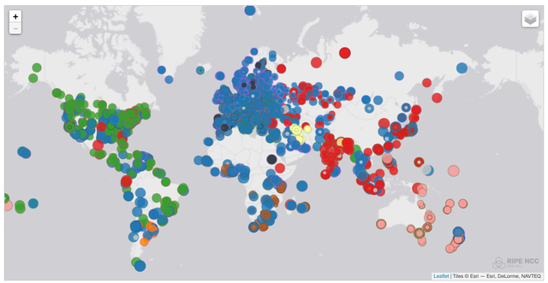
Domain Name System (DNS) Protocol
K-root DNS servers
Distributed
network
Africa (brown), Europe (blue), South America (orange), Asia (red), North America (green), Middle East (yellow) and Oceania (pink)

Slide 10
DNS Domain Hierarchy
Overview
. Root DNS Servers
Root
.com DNS servers
.int DNS servers
.vn DNS servers
Top Level Domain
google.com DNS servers
amazon.com DNS servers
who.int
DNS servers
tuoitre.vn DNS servers
chinhphu.vn DNS servers
Authoritative
Domain namespace is organized in a hierarchical tree-like structure.
Each node is called a domain, or subdomain.
The root of the domain is called ROOT, denoted as ‘.’
Below ROOT, we have Top-Level Domain (TLD)
Ex: In www.example.com, the TLD is .com.
The next level of domain hierarchy is second-level domain (Authoritative) which are usually assigned to specific entities such as companies, schools etc

Slide 11
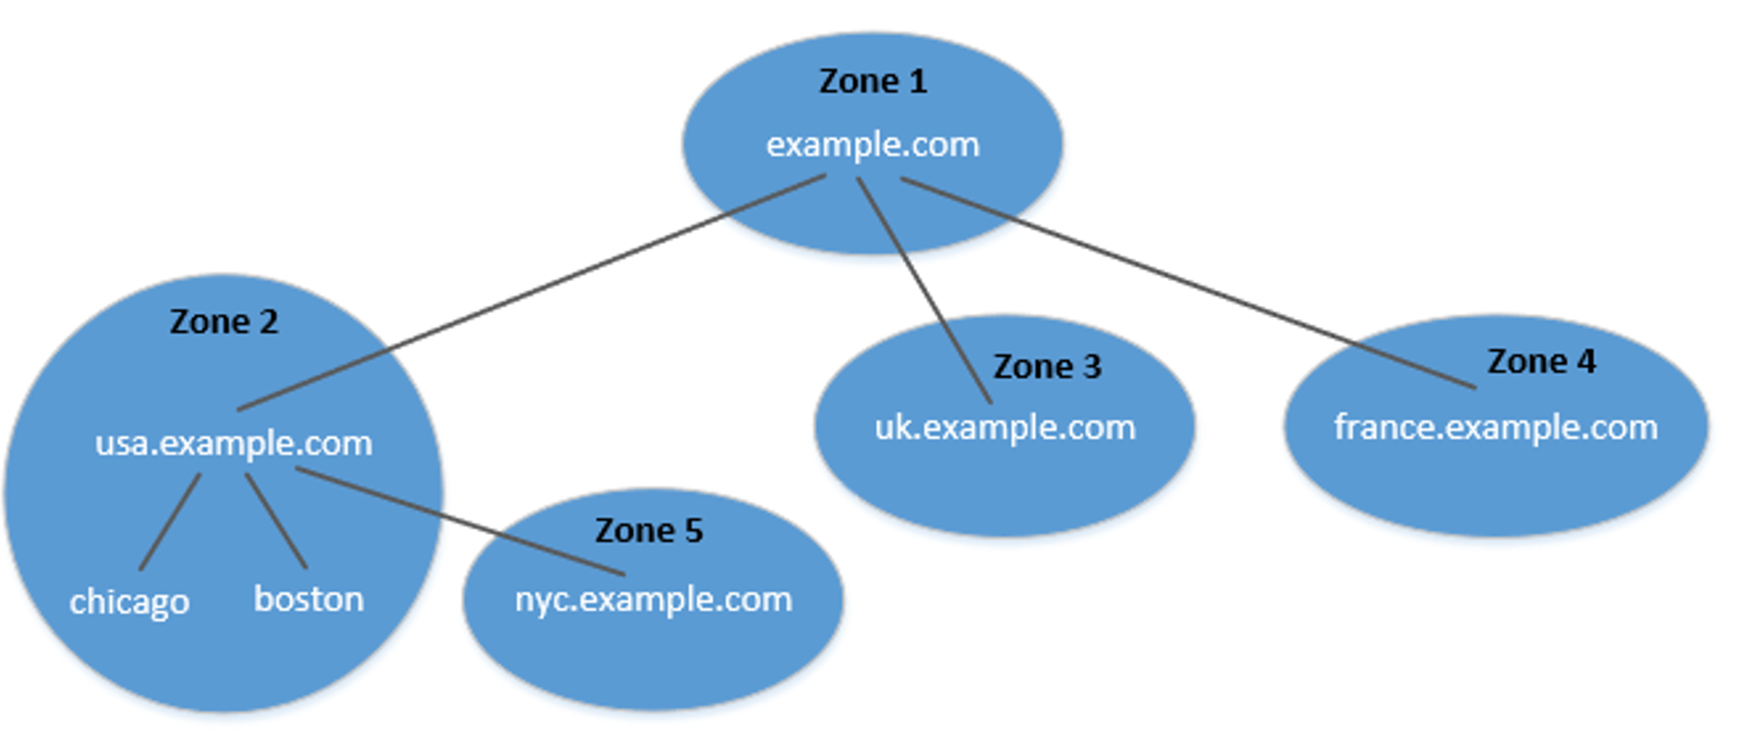
DNS Zone
Overview
DNS is broken up into many different zones
A zone groups contiguous domains and subdomains on the domain tree and
assign management authority to an
entity.
The zone keeps records of who the
authority is for each of its subdomains.
Multiple DNS zones one for each country.
The zone: example.com contains only the DNS records for the hostnames that do not belong to any subdomain
The tree structure depicts subdomains within example.com domain

Slide 12
Authoritative Name Servers
Overview
Each DNS zone has at least one authoritative nameserver that publishes information about the zone.
It provides the original and definitive answers to DNS queries.
An authoritative name server can be a master server (primary) or slave server (secondary).
A master server stores the master copies of all zone records whereas a slave server uses an automatic updating mechanism to maintain an identical copy of the master records.

Slide 13
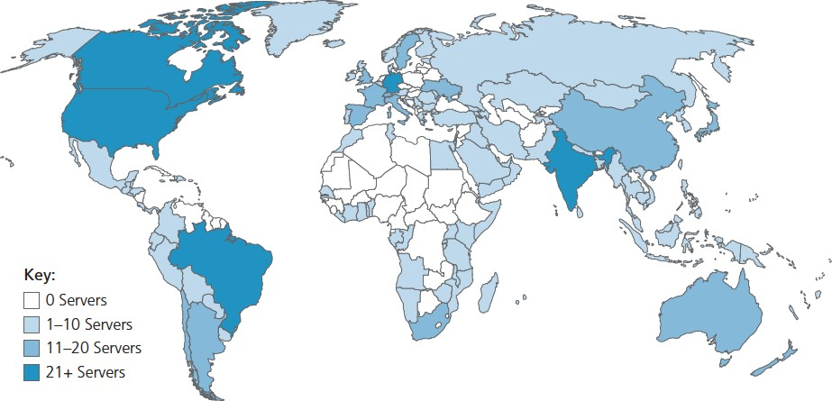
DNS ROOT Servers
Overview
The root zone is called ROOT.
There are 13 logical root zone name “servers” worldwide (each “server” replicated many times)
They provide the nameserver information about all TLDs
https://www.internic.net/domain/root.zone
incredibly important Internet function
They are the starting point of DNS queries.
ICANN (Internet Corporation for Assigned Names and Numbers) manages root DNS domain

Slide 14
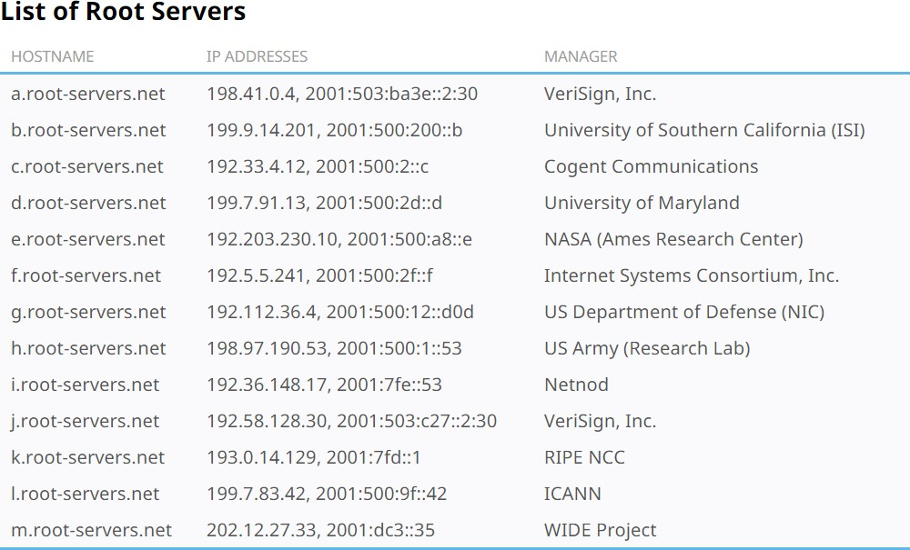
13 DNS root zone
They are the most critical infrastructure on the Internet.
network of hundreds of servers in many countries around the world
https://www.iana.org/domains/root/servers

Slide 15
Top Level Domain (TLD)
Authoritative servers
Infrastructure TLD: .arpa
Generic TLD (gTLD): .com, .net,
Sponsored TLD (sTLD): These domains are proposed and sponsored by private agencies or organizations that establish and enforce rules restricting the eligibility to use the TLD: .edu, .gov, .mil, .travel, .jobs
Country Code TLD (ccTLD): .au (Australia), .vn (Vietnam), .fr (France)
Reserved TLD: .example, .test, .localhost, .invalid

Slide 16












DNS Query Process
Iterated and Recursive query
root DNS server
2
Root
3
TLD DNS server
1
4
TLD DNS server
5
.edu
8
requesting host at
engineering.nyu.edu
local DNS server
dns.nyu.edu
gaia.cs.umass.edu
Authoritative
7
6
.edu (in US)
authoritative DNS server
dns.cs.umass.edu
authoritative DNS server
dns.cs.umass.edu

Slide 17
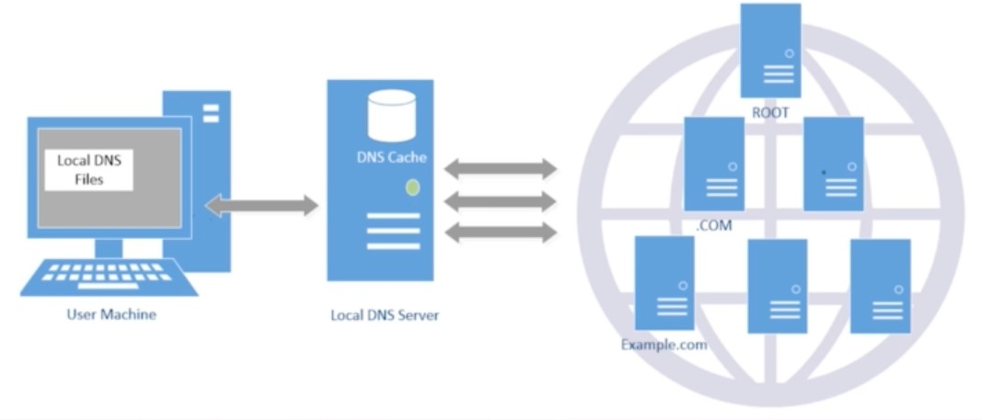
Local DNS name servers
Overview
does not strictly belong to hierarchy
each ISP (residential ISP, company, university) has one
also called “default name server”
when host makes DNS query, query is sent to its local DNS server
has local cache of recent name-to-address translation pairs (but may be out of date!)
acts as proxy, forwards query into hierarchy

Slide 18
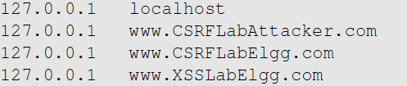
Local DNS Files
Overview
/etc/host: stores IP addresses for some hostnames. Before machine contacts the local DNS servers, it first looks into this file for the IP address.
/etc/resolv.conf: provide information to the machine’s DNS resolver about the IP address of the local DNS server. The IP address of the local DNS server provided by DHCP is also stored here.

Slide 19
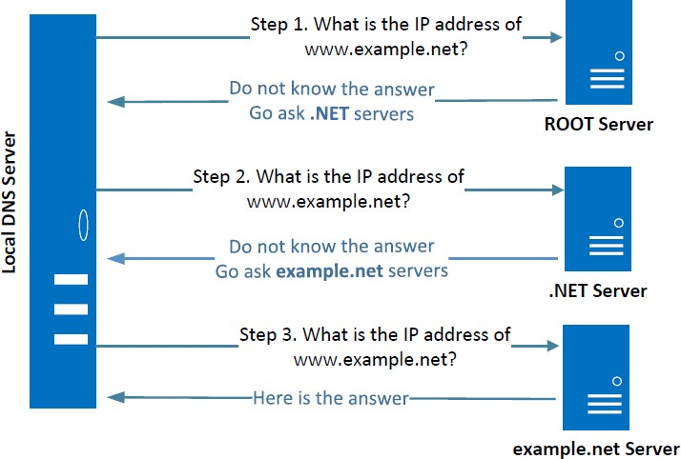
Local DNS Server and Iterative Query Process
Overview
The iterative process starts from the ROOT Server. If it doesn’t know the IP address, it sends back the IP address of the nameservers of the next level server (.NET server) and then the last level server (example.net) which provides the answer.

Slide 20
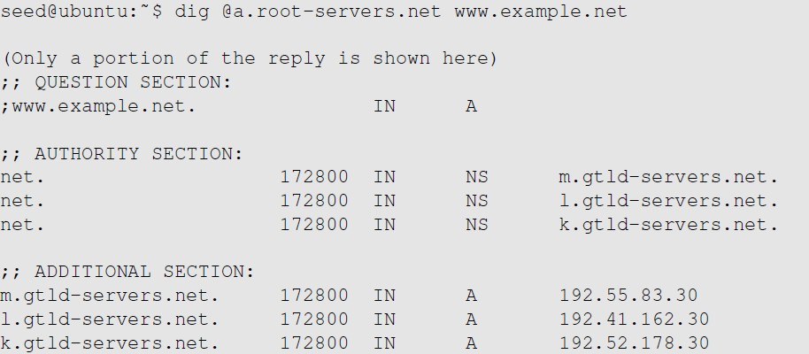
Emulating Local DNS Server (cont.)
Step 1: Ask ROOT
Directly send the query to this server.
No answer (the root does not know the answer)
Go ask them!

Slide 21
DNS Response
Overview
There are 4 types of sections in a DNS response :
Question section : Describes a question to a nameserver
Answer section : Records that answer the question
Authority section : Records that point toward authoritative nameservers
Additional section : Records that are related to the query.
In the above example, we see that as root server doesn’t know the answer there is no answer section, but tells us about the authoritative nameservers (NS Record) along with their IP addresses in the Additional section (A record).

Slide 22
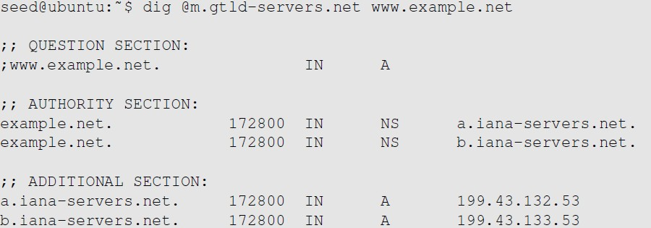

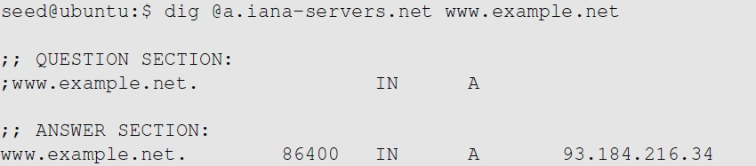
Emulating Local DNS Server
Steps 2-3: Ask .net & example.net DNS servers
Ask a .net nameservers.
Go ask them!
Ask an example.net
nameservers.
Finally got the answer

Slide 23
DNS cache
Step 4: Caching
When the local DNS server gets information from other DNS servers, it caches the information.
Each piece of information in the cache has a time-to-live value, so it will be eventually time out and removed from the cache.

Slide 24
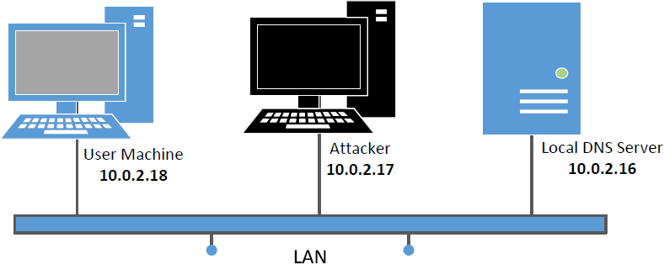
Set Up DNS Server and Experiment Environment
Experiment Environment
We will use this setup for our experiment

Slide 25
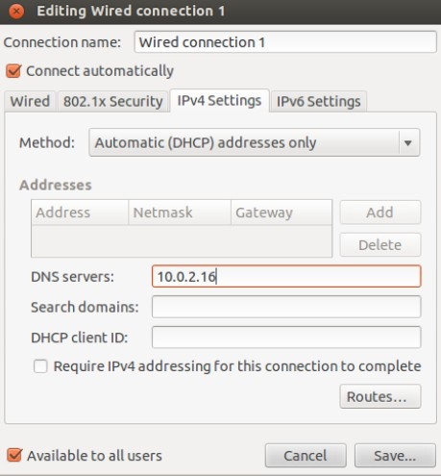
Setup: User Machine
Experiment Environment
Need to modify /etc/resolv.conf
DHCP may overwrite this file, we need to tell DHCP client to manually set the DNS server in this file, and then never modify it thereafter.

Slide 26
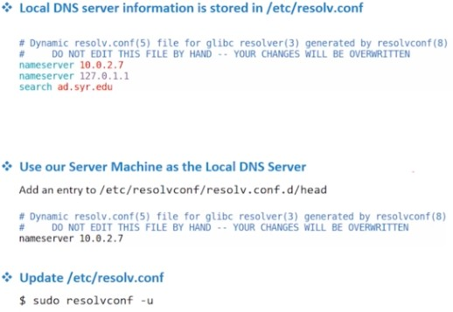
Setup: User Machine
Experiment Environment
Need to modify /etc/resolv.conf
DHCP may overwrite this file, we need to tell DHCP client to manually set the DNS server in this file, and then never modify it thereafter.
More reliable way!

Slide 27
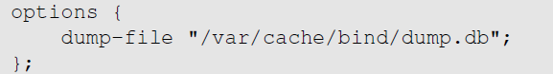
Configure Local DNS Server
Setup
Install BIND 9 DNS server: sudo apt-get install bind9
Configure BIND 9 server
BIND 9 gets its configuration from /etc/bind/named.conf,
The file contains several “include” entries. One of the entries is
“/etc/bind/named.conf.options”.
In this file, we can specify where the DNS cache is to be dumped.
Commands related to DNS cache

Slide 28
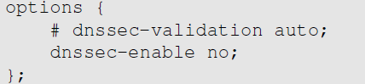
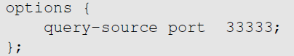
Configure Local DNS Server: Simplification
Setup
Turn Off DNSSEC: DNSSEC is used to protect against spoofing attacks on DNS servers. To simplify our experiment, we need to turn it off. Modify named.conf.options:
Use fixed source port (to simplify our experiment): Modify
named.conf.options
Restart DNS Server: sudo service bind9 restart

Slide 29
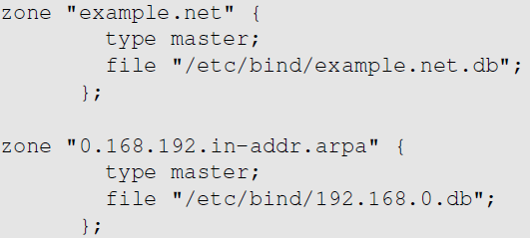
Set Up DNS Zones on Local DNS Server
Setup
Create zones: Create two zone entries in the DNS server by adding them to
/etc/bind/named.conf.
For forward lookup (Hostname → IP).
For reverse lookup (IP → hostname).

Slide 30
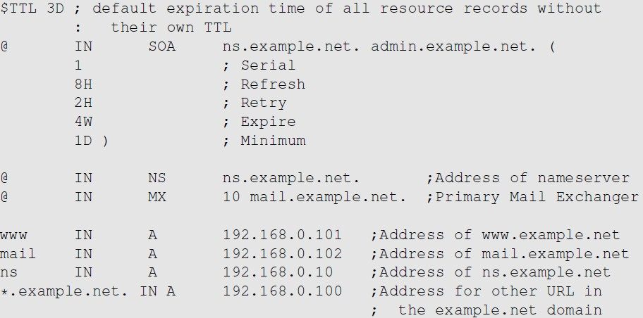
Zone File for Forward Lookup
Setup
/etc/bind/example.net.db (The file name is specified in named.conf)
@: Represents the origin specified in named.conf (string after “zone”) [example.net]

Slide 31
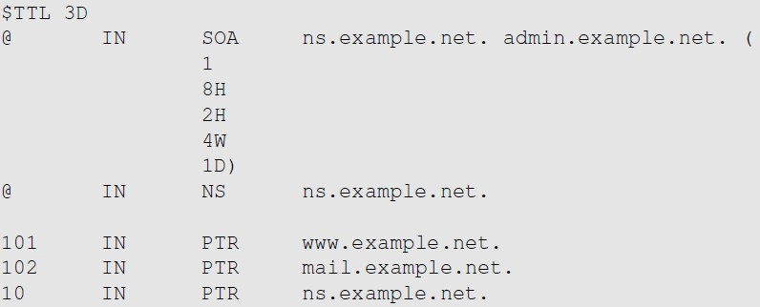
Zone File for Reverse Lookup
Setup
/etc/bind/192.168.0.db: (The file name is specified in named.conf)

Slide 32
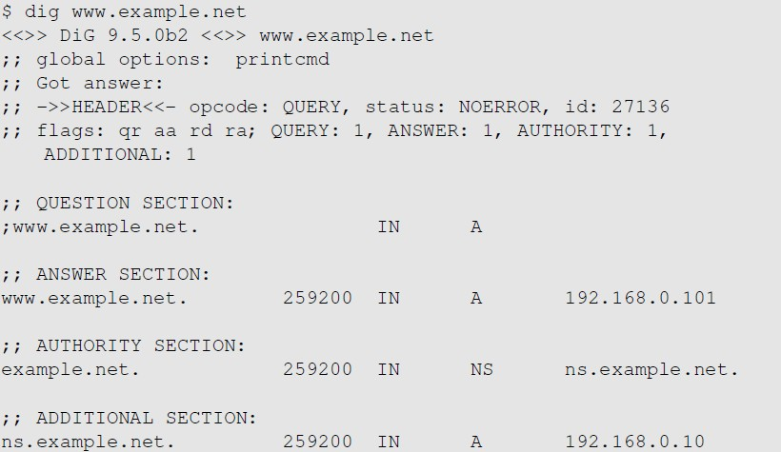
Testing Our Setup
Setup
Task: Setup two similar zones on Attacker machine

Slide 33
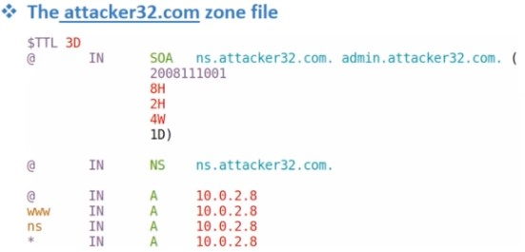
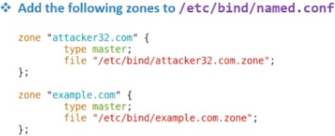
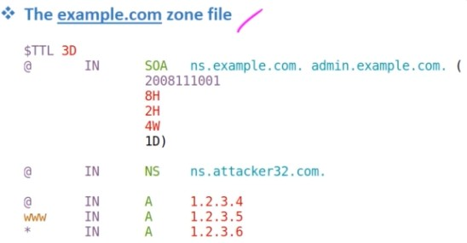
Set Up Two Zones on Attacker VM
Attacker VM setup

Slide 34
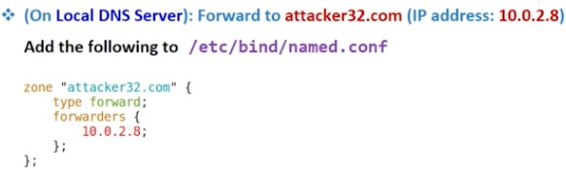
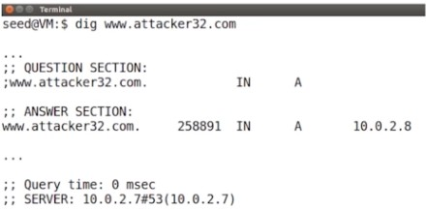
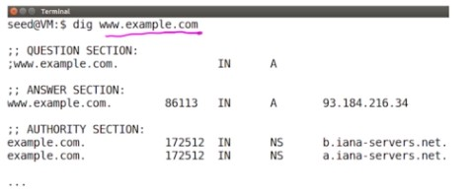
Forward Zone Query to the Attacker VM
On Local DNS server
How Do Local DNS Server find attacker32.com's nameserver?
Forwarders: directly go to NS: 10.0.2.8
Test the Complete Setup on User VM
Real IP

Slide 35
DNS Attacks
Attack types
Denial-of-Service Attacks (DoS): When the local DNS servers and the authoritative nameservers do not respond to the DNS queries, the machines cannot retrieve IP addresses which essentially cuts down the communication.
DNS Spoofing Attacks:
o Primary goal: provide a fraudulent IP address to victims, tricking them to communicate with a machine that is different from their intention.
o Example: If a user’s intention is to visit a bank’s web site to do online banking, but the IP address obtained through the DNS process is attacker’s machine, the user machine will communicate to the attacker’s web server.

Slide 36
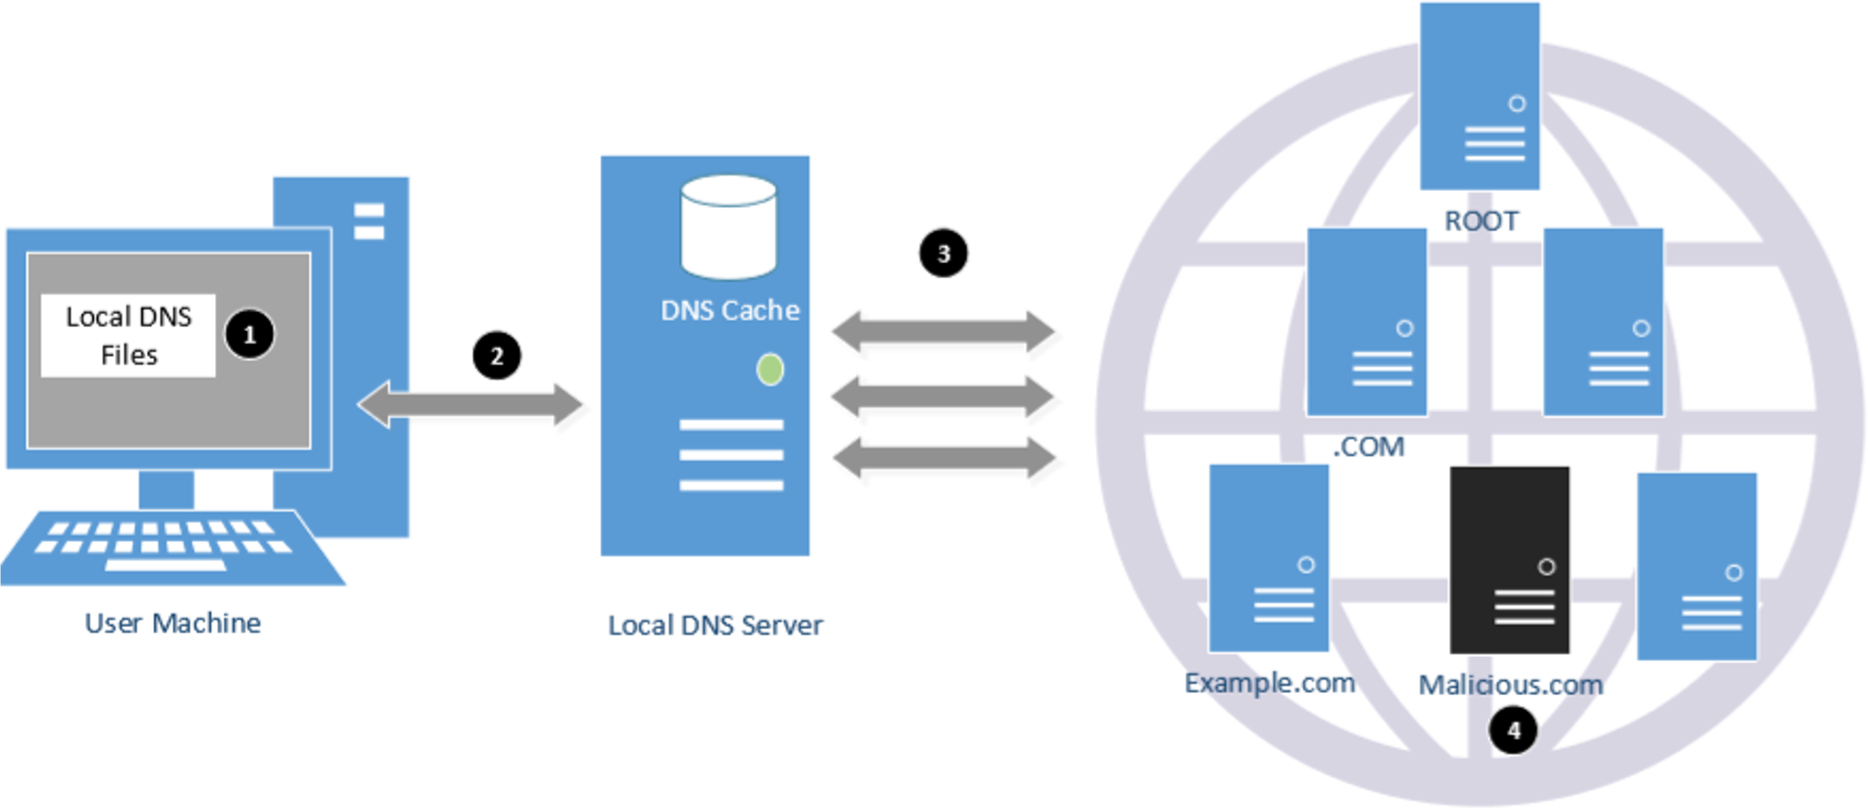
Overview of the Attack Surfaces
Attack strategies

Slide 37
DNS Attacks on Compromised Machines
Local DNS files
If attackers have gained the root privileges on a machine,
Modify /etc/resolv.conf: use malicious DNS server as the machine’s local DNS server and can control the entire DNS process.
Modify /etc/hosts: add new records to the file, providing the IP addresses for some selected domains. For example, attackers can modify IP address of www.bank32.com which can lead to attacker’s machine.

Slide 38
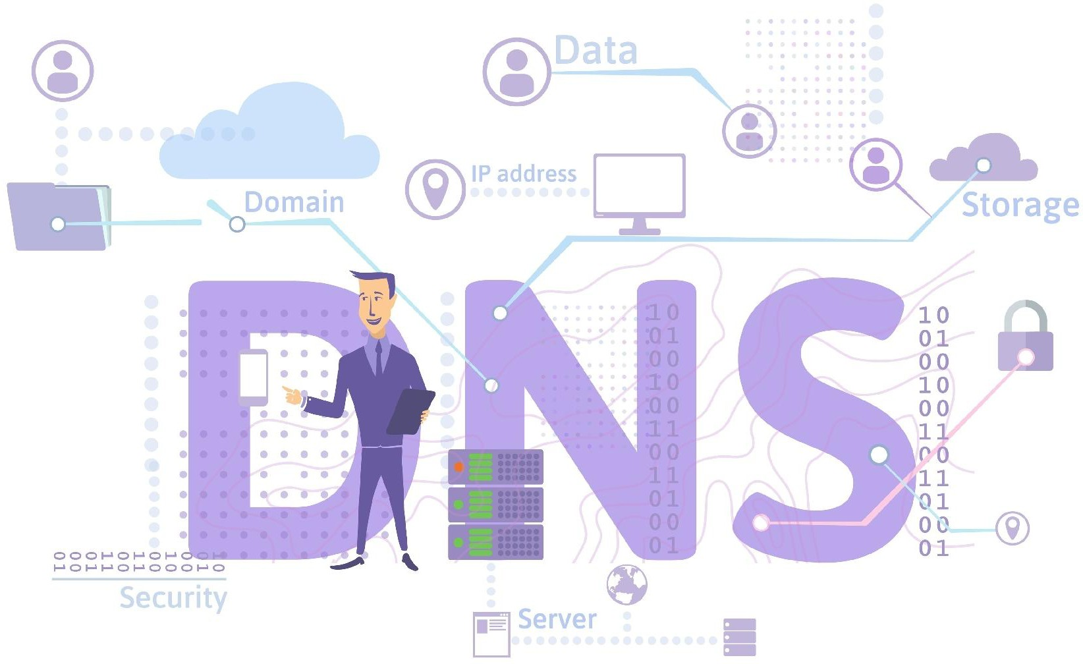
Local DNS attack
Cache Poisoning Attack

Slide 39
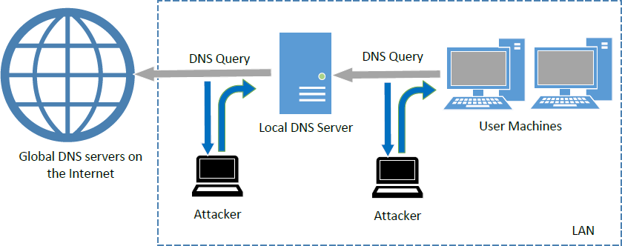
Sniffing and Spoofing DNS Replies
Attack from LAN
NT101 – Network Security
Winter 2020

Slide 40
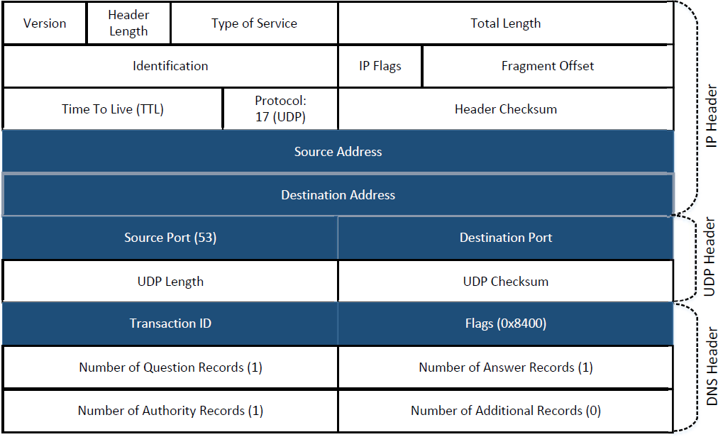
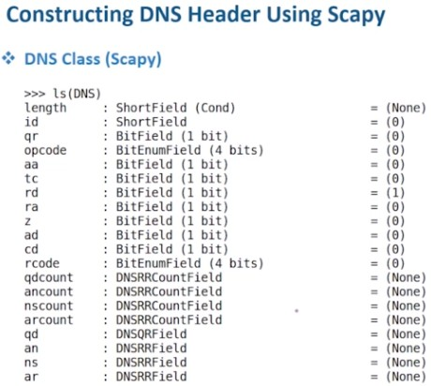
Constructing Spoofed DNS Response
Local DNS Attack
Destination IP = Local DNS Server

Slide 41
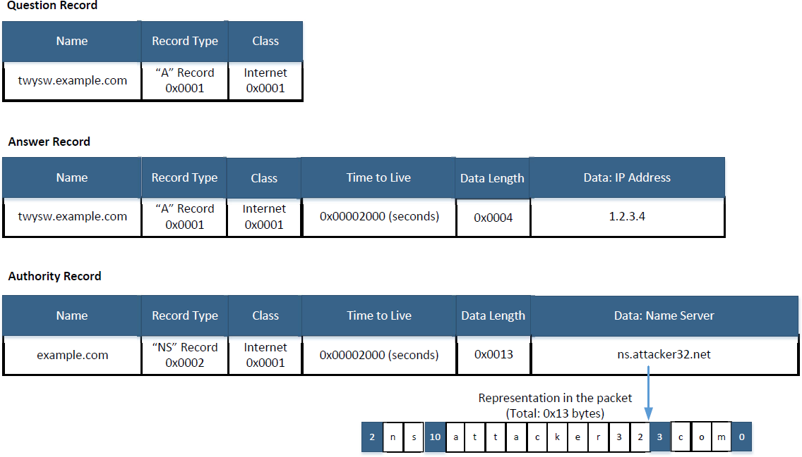
Spoofing Replies: DNS Header and Payload
Constructing Spoofed DNS Response

Slide 42
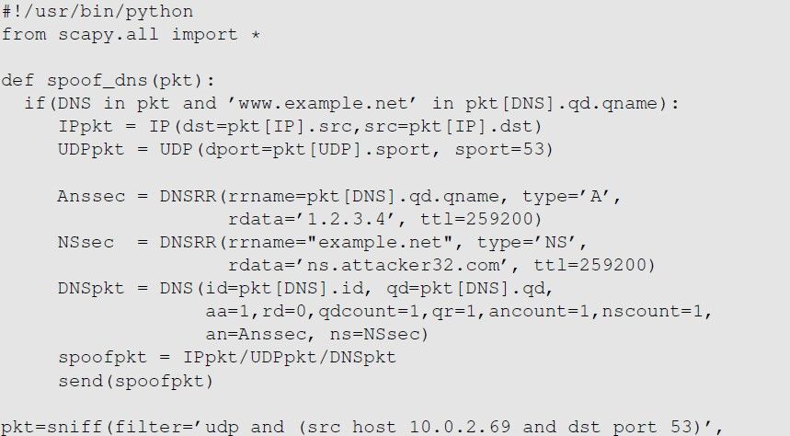
Local DNS Cache Poisoning Attack
Attacking code
Goal: Forge DNS replies after seeing a query from Local DNS Server

Slide 43
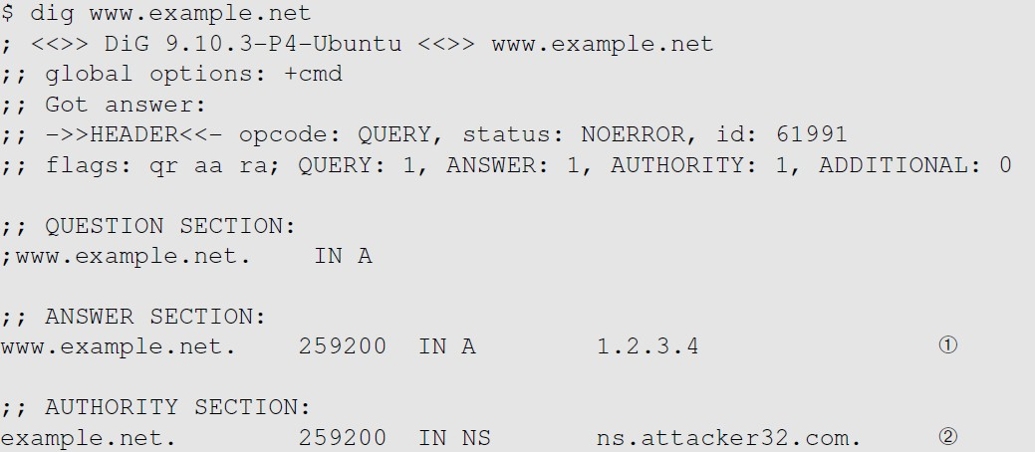
Local DNS Cache Poisoning Attack
Results

Slide 44
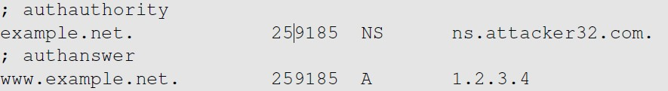
Inspect the Cache
Results
Run “sudo rndc dumpdb –cache” and check the contents of “/var/cache/bind/dump.db”.
Hijack the Entire Domain
Clean the cache using “sudo rndc flush” before doing the attack.

Slide 45
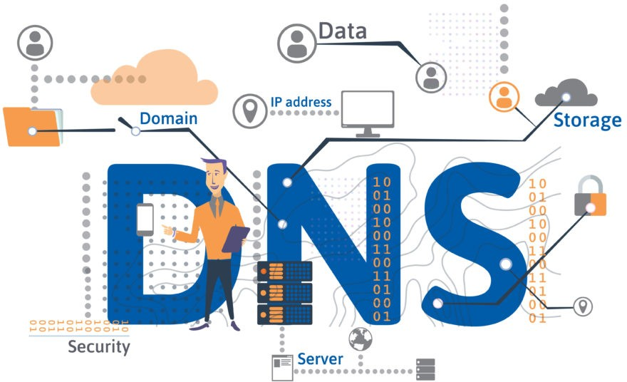
Remote DNS
Cache Poisoning Attack

Slide 46
Challenges
Remote DNS Attack
Challenge 01: Forging DNS Replies
For remote attackers who are not on the same network as the local DNS server, spoofing replies is much more difficult, because they need to guess two random numbers used by the query packet:
Source port number (16-bit random number)
Transaction ID (16-bit random number)
Challenge 02 - The Timing of the Spoofing
Challenge 03 - Cache effect (the bigger problem!): If one attempt fails, the actual reply will be cached by local DNS server; attacker need to wait for the cache to timeout for the next attempt.

Slide 47
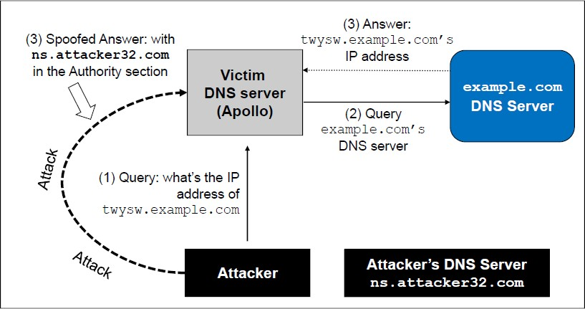
The Kaminsky Attack
Brilliant DNS attack idea
How can we keep forging replies without worrying about the cache effect?
Kaminsky’s Idea:
Ask a different question every time, so caching the answer does not matter, and the local DNS server will send out a new query each time.
Provide forged answer in the Authority section

Slide 48
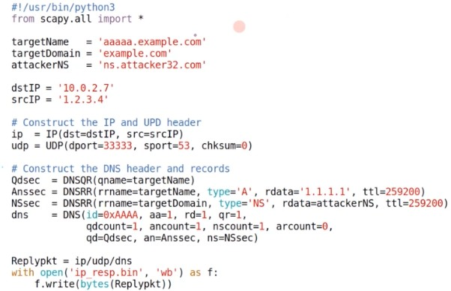
Create a Spoofed Response
Create Spoofed DNS packet using Scapy (Save it to a file)
← most important

Slide 49
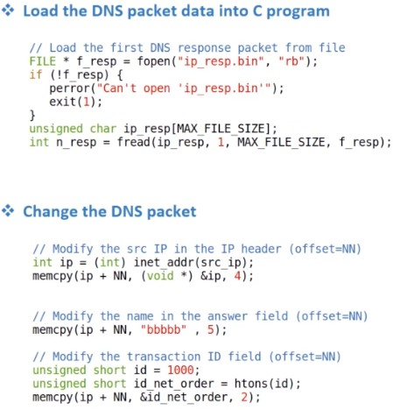
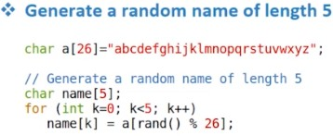
Create a Spoofed Response
Sending the Spoofed Response Using C - Code template!

Slide 50
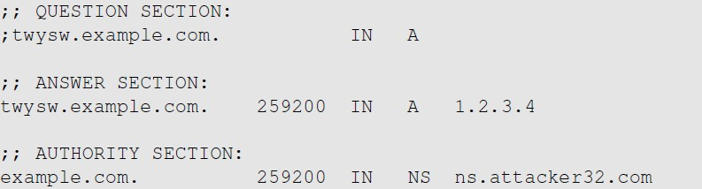
The Kaminsky Attack
A Sample Response
This random name will change for each attack
attempt
This answer does
not matter
This is what we want the local DNS server to cache
Tell the DNS server to use this one as the nameserver for the example.com domain

Slide 51
Countermeasures
Protecting Against DNS Cache Poisoning Attacks

Slide 52
DNSSEC
Protection Against DNS Cache Poisoning Attacks
DNSSEC is a set of extension to DNS, aiming to provide authentication and integrity checking on DNS data.
With DNSSEC, all answers from DNSSEC protected zones are digitally signed.
By checking the digital signatures, a DNS resolver is able to check if the information is authentic or not.
DNS cache poisoning will be defeated by this mechanism as any fake data will be detected because they will fail the signature checking.

Slide 53
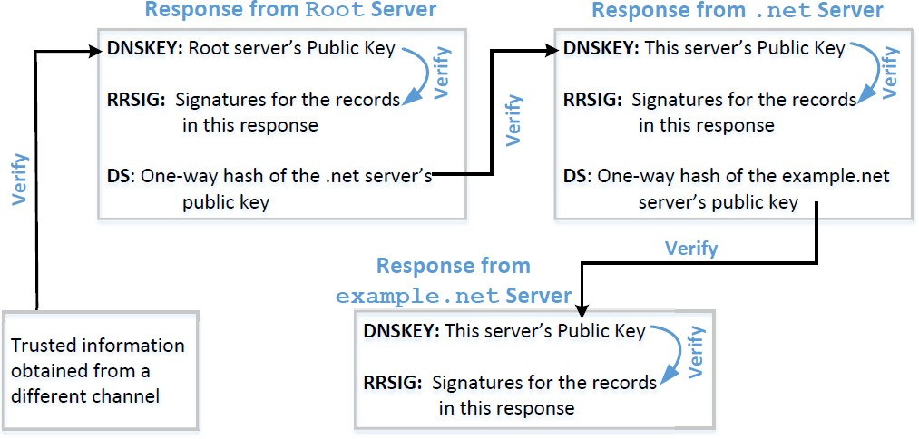
Protection Using DNSSEC
Protection Against DNS Cache Poisoning Attacks

Slide 54
Protection Using TLS/SSL
Protection Against DNS Cache Poisoning Attacks
Transport Layer Security (TLS/SSL) protocol provides a solution against the cache poisoning attacks.
After getting the IP address for a domain name (www.example.net) using DNS protocol, a computer will ask the owner (server) of the IP address to proof that it is indeed www.example.net.
The server has to present a public-key certificate signed by a trusted entity and demonstrates that it knows the corresponding private key associated with www.example.net (i.e., it is the owner of the certificate).
HTTPS is built on top of TLS/SSL. It defeats DNS cache poisoning attacks.

Slide 55
DNSSEC versus TLS/SSL
Protection Against DNS Cache Poisoning Attacks
Both DNSSEC and TLS/SSL are based on the public key technology, but their chains of trust are different.
DNSSEC provides chain of trust using DNS zone hierarchy, so nameservers in the parent zones vouch for those in the child zones.
TLS/SSL relies on Public Key Infrastructure which contains Certificate Authorities vouching for other computers.

Slide 56
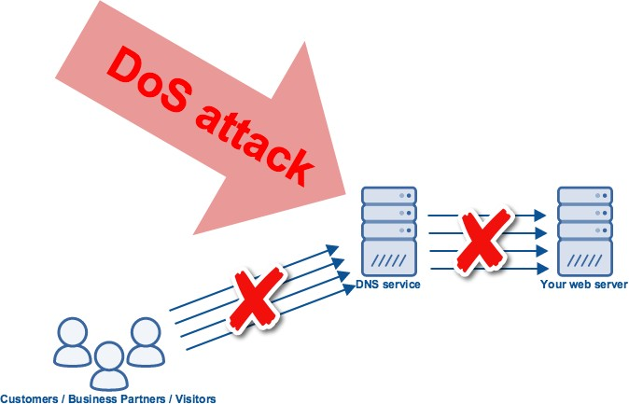
Attacks from Malicious DNS Server

Slide 57
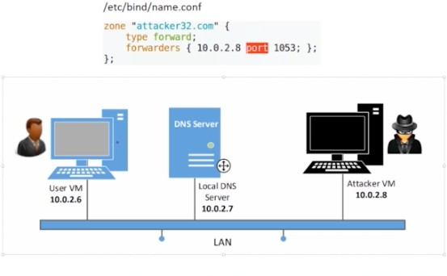
Experiment Setup
Attack from Malicious DNS Server

Slide 58
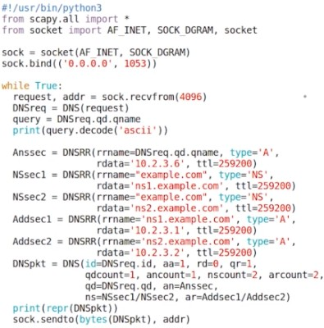
Attacks from Malicious DNS Server
Write a Malicious DNS Server
When a user visits a website, such as attacker32.com, a DNS query will eventually come to the authoritative nameserver of the attacker32.com domain.
In addition to providing an IP address in the answer section of the response, DNS server can also provide information in the authority and additional sections.
Attackers can use these sections to provide fraudulent information.

Slide 59
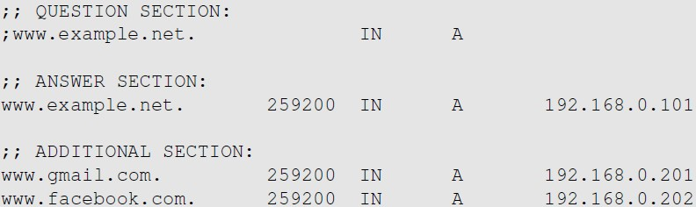
Fake Data in the Additional Section
Attack from Malicious DNS Server
Additional information is
provided
They will be discarded: out of zone. They will cause security problems if not discarded.

Slide 60
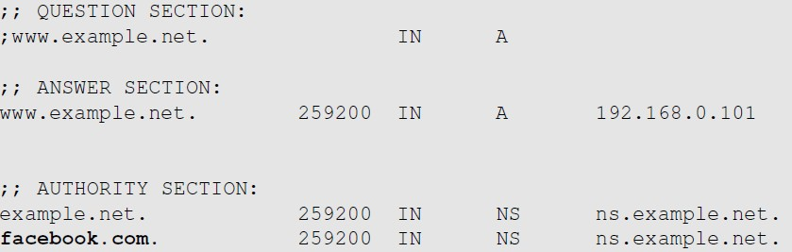
Fake Data in the Authority Section
Attack from Malicious DNS Server
This one is allowed
This one is out of zone, and should be discarded

Slide 61
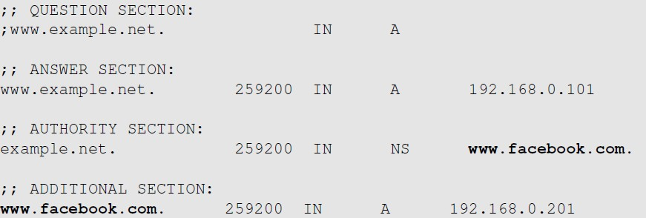
Reply Forgery Attacks from Malicious DNS Servers
Attack from Malicious DNS Server
This one is allowed
This one is not allowed (out of zone). The local DNS server will get the IP address of this hostname by itself.
Homework: What is the use of the Additional Records?

Slide 62
Reply Forgery in Reverse DNS Lookup
Attack from Malicious DNS Server
In the reverse lookup, a DNS query tries to find out the hostname for a given IP address.
Question: Can we use the hostname obtained from reverse DNS lookup as the basis for access control?
o Example: Packets from syr.edu are allowed to access certain services.
To answer this question, we need to know how to do reverse lookup

Slide 63
Reply Forgery Attacks from Malicious DNS Servers
Attack from Malicious DNS Server
Example:
Given an IP address, 128.230.171.184, the DNS resolver constructs a “fake name” 184.171.230.128.in-addr.arpa and then send queries through an iterative process.
We emulate the entire reverse lookup process using @ option in the dig command.

Slide 64
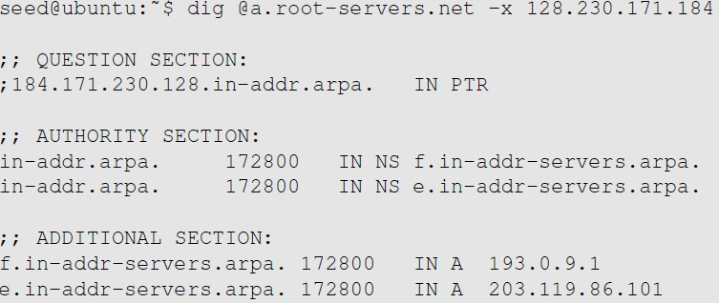
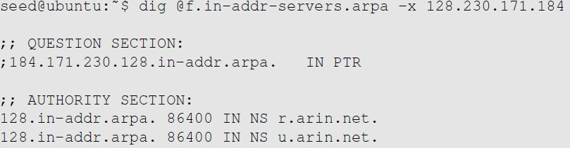
Reverse DNS Lookup
Emulating the reverse lookup process
Step 1: Ask a root server. We get the nameservers for the in-addr.arpa zone.
Step 2: Ask a nameserver of the in-addr.arpa zone. We get nameservers for the 128.in-addr.arpa zone

Slide 65


Reply Forgery Attacks from Malicious DNS Servers
Emulating the reverse lookup process
Step 3: Ask a nameserver of the 128.in- appr.arpa zone. We get the nameservers for the 203.128.in-addr.arpa zone
Step 4: Ask a nameserver of the 230.128.in- appr.arpa zone. We get the final result

Slide 66
Review Our Question
Reverse DNS lookup
Question: Can we use the hostname obtained from reverse DNS lookup as the basis for access control?
Answer:
If a packet comes from attacker, the reverse DNS lookup will go back to the attacker’s nameserver.
Attackers can reply with whatever hostnames they want.

Slide 67

Other DNS Attacks
Rebinding and DoS attack

Slide 68


DNS Rebinding Attack
Attack surfaces
Providing Fake IP in the Answer section: Is there any damage?
→ In certain scenario, related to IoT: bypass the Same Origin policy
Lab Setup

Slide 69



How to Interact with the loT Device
Simple protection

Slide 70

Understanding the Same Origin Policy
Same Origin vs Cross Origin

Slide 71



DNS Rebinding Attack
Attack surfaces
Firewall
Ajax
code
Web page with JavaScript code
Same Origin Policy
Attacker
The target server (vulnerable)
Attack goal: interact with the target server from outside

Slide 72

DNS Rebinding Attack
Attack procedure

Slide 73
Denial of Service Attacks on Root Servers
DoS attacks
Attacks on the Root and TLD Servers :
Root nameservers: If the attackers can bring down the servers of the root zone, they can bring down the entire Internet. However, attack root servers is difficult:
The root nameservers are highly distributed. There are 13 (A,B….M) root nameservers (server farm) consisting of a large number of redundant computers to provide reliable services.
As the nameservers for the TLDs are usually cached in the local DNS servers, the root servers need not be queried till the cache expires (48 hrs). Attacks on the root servers must last long to see a significant effect.

Slide 74
Denial of Service Attacks on TLD Servers
DoS attacks
Nameservers for the TLDs are easier to attack.
TLDs such as gov, com, net etc have quite resilient infrastructure against DOS attacks. But certain obscure TLDs like country-code TLDs do not have sufficient infrastructure.
→ the attackers can bring down the Internet of a targeted country.

Slide 75

Attacks on Nameservers of a Particular Domain
Example
UltraDNS: DNS provider for many major e-commerce companies such as Amazon, Walmart, Expedia. In 2004, DOS against this provider was launched which suffered an outage for an hour.

Slide 76



Attacks on Nameservers of a Particular Domain
Example
Dyn network : In 2016, multiple DDoS attacks were launched against a major DNS service provider for companies like CNN, BBC, HBO, PayPal etc. The attacks are believed to have been launched through botnet consisting of different IoT devices like IP cameras, baby monitors etc. It caused major Internet services unavailable .

Slide 77
Summary
What have we learned?
How DNS works
Spoofing Attacks on DNS
Local DNS cache poisoning attacks
Remote DNS cache poisoning attacks
Reply forgery attacks
Defense against DNS spoofing attacks
DNSSEC
TLS/SSL
DNS Rebinding attack and Denial of Services on DNS

Slide 78



Homework
Lab exercise
Lab 1: Local DNS Attack Lab (Link - optional)
In this lab, students will launch DNS cache poisoning attack in a LAN environment.
Lab 2: Remote DNS Attack Lab (Link)
In this lab, students will launch the remote DNS cache poisoning attack, i.e., the Kaminsky attack.
Lab 3: DNS Rebinding Attack Lab (Link)
The objective of this lab is two-fold: (1) demonstrate how the DNS rebinding attack works, and (2) help students gain the first- hand experience on how to use the DNS rebinding technique to attack IoT devices.
Working in a team (your final-project team) or individually.

Slide 79

For next time…
Looking ahead
Ready for next class (the last lecture):
Tentative topic: Network defenses: cryptographic-based solutions and Firewall
Reading and practicing (in advance):
SEED book, Chapter 17
Refs: https://www.handsonsecurity.net/resources.html
SEED Lab: Linux Firewall Exploration Lab
Refs: https://seedsecuritylabs.org/Labs_20.04/Networking/Firewall/

Slide 80

Today end,
Congrats!

